Slide 1
Colorado River and Water Scarcity
By Kurt Semm

Slide 2
Dissertation
Colorado River water scarcity from a political economy perspective.
Water Scarcity Increasing in Colorado River due to Climate Change.
Issue?

Slide 4
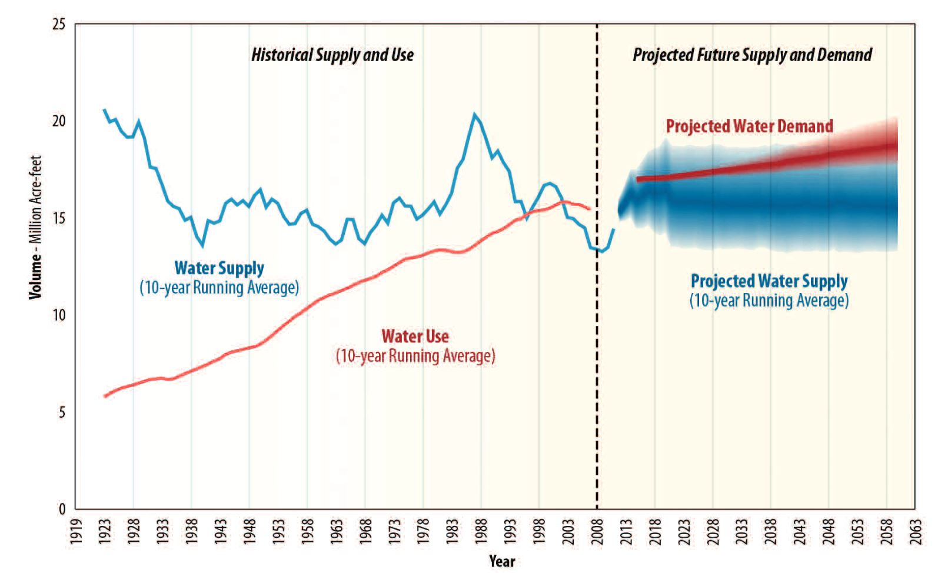

Slide 5
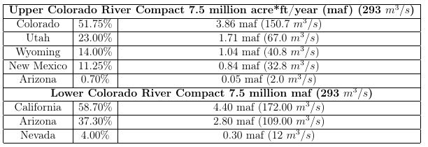

Slide 6
Economic Conception of Water
Literature Review
First chapter adopt the Economic Conception of Water, W.M Hanemann. Pure Economics.
Meeting with Jamee Moudud on Friday to discuss the legal aspect with in the “Economic Conception of Water.”
“Law of the River: Commodification”
Reach out to Native American and other water conservation groups. Get their perspective.

Slide 7
Chapter 2 – Class Analysis of Water Use
Next chapter, Input-output table to see how the Colorado River water is used and distributed. In production and residential.
Arrange meeting with Cinzia
Marx’s Class structure – Where do people fit, and can we use these to fit the bins in our distributions of water consumption.
Talked to Duncan. Use class structure to form bins for distribution and then you can analyze average price of water.

Slide 8
Chapter 3 – Usefulness of Desalination
Class Analysis of Water and examine the impact of a Tariff block water.
Does it impact lower income people more?
Austerity?
Businesses and Higher income.
Water use versus what they pay.
Who pays more? Marginally or averagely.
Hamiltonian → problem with Method. Marginal price of water
How water tariffs are implemented

Slide 9
Next Steps…
Meet with Cinzia Aruzza.
Class Dynamics and how to structure class in Marxian Analysis.
Meeting with Anwar, to introduce topic.

